Slide 1








A 2-days National Level Hackathon on
AI in education
COMPETITIVE EXAMS
Neuronext
Trisha Devadhe
04/09/2025
Ayodhya Bypass Near Minaal Residency, 462041,BHOPAL,M.P.
www.samadhan.sistec.ac.in/

Slide 2


AREA OVERVIEW
• Personalized learning is often missing in traditional education.
• Students juggle multiple tools (notes, planners, quizzes, trackers).
• AI can unify and simplify the entire learning experience.
IMPORTANCE OF AREA
• Personalized education boosts engagement & outcomes.
• Real-time AI support reduces dependence on external coaching.
• Helps students learn at their own pace while staying consistent.

Slide 3
Potential Challenges and Opportunities
Challenges:
• Lack of adaptive teaching in classrooms.
• Students face difficulty managing schedules & monitoring progress.
• Limited access to personalized feedback at scale.
Opportunities:
• AI can automate scheduling, teaching, and assessment.
• Creates a unified platform instead of scattered tools.
• Enables scalable, affordable, and personalized learning worldwide.

Slide 4
Preliminary Solution Concept
Edu-Sprint = One AI assistant for the student’s entire journey
• Plans personalized study schedules.
• Teaches concepts through interactive Q&A.
• Tests with adaptive quizzes.
• Tracks learning progress in real-time.

Slide 5
Key Features and Functionalities
• AI Question Answering: Instant doubt resolution
• Personalized Scheduling: Daily learning plan
• Adaptive Quizzes: Adjusts difficulty as student learns
• Live Progress Dashboard: Tracks strengths & weaknesses
• Gamification: Rewards, streaks, and achievements

Slide 6
Target Users and Expected Use Cases
Target Users:
• School & college students
• Teachers & parents (monitoring)
• Lifelong learners / competitive exam aspirants
Use Cases:
• Student asks AI doubt → gets instant explanation
• AI generates daily timetable → reminders keep student on track
• AI tests student with adaptive quiz → updates dashboard
• Teacher/parent monitors progress report

Slide 7
Data Requirements and Privacy Considerations
Data Requirements:
• Student profile (class, subjects, goals)
• Performance data (quiz scores, time spent)
• Interaction data (questions asked, topics studied)
Privacy Considerations:
• All data stored securely & encrypted
• No sharing with third parties without consent
• Anonymized analytics for improving system

Slide 8
AI Technologies and Methods
• NLP (Natural Language Processing): For doubt-solving & conversations
• Machine Learning: Adaptive quizzes & personalized scheduling
• Data Analytics: Progress tracking & performance insights
• Recommendation Algorithms: Next best topic & revision cycles

Slide 9
Implementation Approach
Phase 1: Build chatbot prototype (basic Q&A + scheduling)
Phase 2: Add adaptive quiz engine & dashboard
Phase 3: Integrate gamification & parent/teacher reports
Tools: Python, TensorFlow/PyTorch, LangChain, Firebase/SQL, Flutter (for app UI)
Timeline: 3–6 months MVP, expandable

Slide 10
Evaluation Metrics
• Student engagement (daily active users, study streaks)
• Accuracy of AI answers & quiz adaptiveness
• Improvement in student performance scores
• Time saved in planning & doubt-solving
• User satisfaction & retention rate

Slide 11
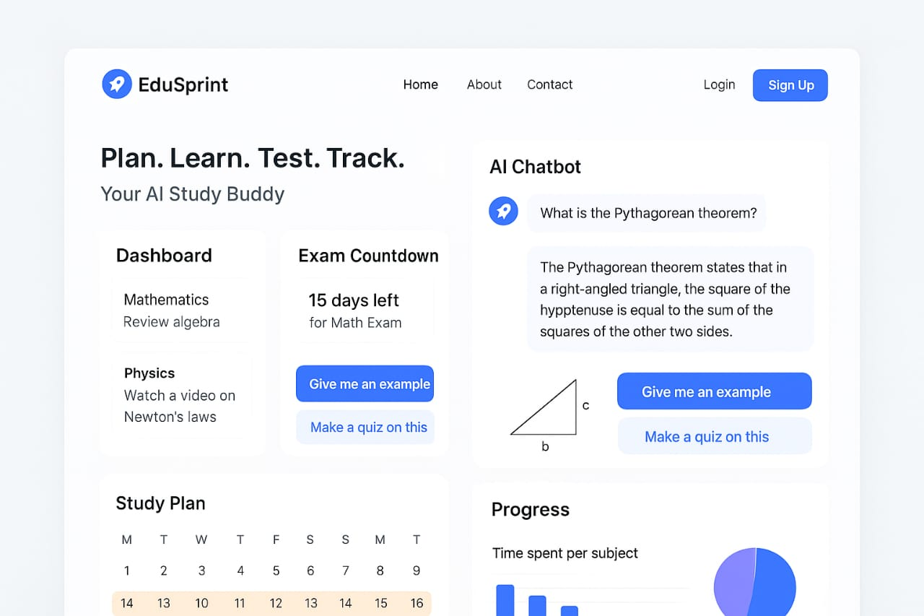
EDU-SPRINT UI

